Slide 1


Understand the core Azure architectural components
Nicolas Blank
Alistair Pugin

Slide 2

Agenda
Describe
describe Regions
Describe
describe Availability Zones
Describe
describe Resource Groups
Describe
describe Azure Resource manager
Describe
describe the benefits and usage of core Azure architectural components

Slide 3
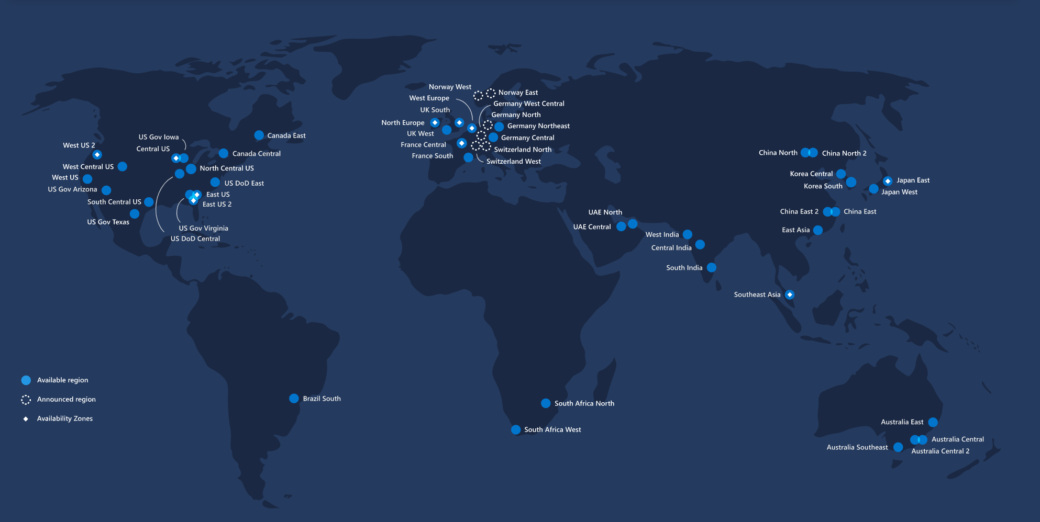

Hyperscale datacentre infrastructure
“Go-local” strategy
56 regions
2 National Clouds
More regions than any other CSP

Slide 4
Hyperscale datacentre infrastructure Terminology
Region
Set of datacenters in the same metro area
Number and exact location of DC facilities not exposed to end users
Any two VMs hosted in the same region are less than 2ms away from each other (RTT)
Inter-DC switching bandwidth in a region up to 1.6 Pb/s, depending on the region DC capacity (MW)
Availability zones (only in select regions)
Logical partitioning of DC facilities in a region based on geographical position
Each partition is an availability zone
Any two VMs in the same availability zone are less than 1ms away from each other (RTT)
DC facilities in each zone have independent power, cooling and network
DC facilities in each zone are distant enough from other zones not to be impacted by adverse events (e.g. fires) ate the same time
Geography
Set of regions in the same geo-political area
Can be a country, or a continent

Slide 5
Hyperscale datacentre infrastructure Terminology – RSA example
“South Africa North” is a region
“South Africa West” is a region

Slide 6
Hyperscale datacentre infrastructure Terminology – RSA example
“Africa” is a geography with two regions

Slide 7
Azure Resource Manager
Resource
Resource group
Resource provider
Resource Manager template
Declarative syntax
Notes:
resource - A manageable item that is available through Azure. Virtual machines, storage accounts, web apps, databases, and virtual networks are examples of resources.resource group - A container that holds related resources for an Azure solution. The resource group includes those resources that you want to manage as a group. You decide which resources belong in a resource group based on what makes the most sense for your organization. See Resource groups.resource provider - A service that supplies Azure resources. For example, a common resource provider is Microsoft.Compute, which supplies the virtual machine resource. Microsoft.Storage is another common resource provider. See Resource providers and types.Resource Manager template - A JavaScript Object Notation (JSON) file that defines one or more resources to deploy to a resource group or subscription. The template can be used to deploy the resources consistently and repeatedly. See Template deployment overview.declarative syntax - Syntax that lets you state "Here is what I intend to create" without having to write the sequence of programming commands to create it. The Resource Manager template is an example of declarative syntax. In the file, you define the properties for the infrastructure to deploy to Azure. See Template deployment overview.

Slide 8
Benefits of Using Resource Manager
Manage
Manage your infrastructure through declarative templates rather than scripts.
Deploy, manage, and monitor
Deploy, manage, and monitor all the resources for your solution as a group, rather than handling these resources individually.
Redeploy
Redeploy your solution throughout the development lifecycle and have confidence your resources are deployed in a consistent state.
Define
Define the dependencies between resources so they're deployed in the correct order.
Apply
Apply access control to all services in your resource group because Role-Based Access Control (RBAC) is natively integrated into the management platform.
Apply
Apply tags to resources to logically organize all the resources in your subscription.
Clarify
Clarify your organization's billing by viewing costs for a group of resources sharing the same tag.

Slide 9
Understand Scope
four levels of scope:
management groups,
subscriptions,
resource groups,
resources
Notes:
You apply management settings at any of these levels of scope. The level you select determines how widely the setting is applied. Lower levels inherit settings from higher levels. For example, when you apply a policy to the subscription, the policy is applied to all resource groups and resources in your subscription. When you apply a policy on the resource group, that policy is applied the resource group and all its resources. However, another resource group doesn't have that policy assignment.

Slide 10
Putting it all together
Azure Regions, Availability Zones, Resource Groups, and the Azure Resource Manager are building blocks of any azure solution
Regions are locations where Azure resources are deployed
Availability Zones provide redundancy
Resource groups group and manage related resources
Resource Manager provides the management platform and functionality for all Azure resources

Slide 11

Questions ?

